Slide 1


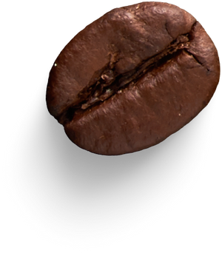
Cafetaria Management
Team members :
G THOSHAN -24KB1A3026
K BHARGAV ROYAL -24KB1A3039
R LAKSHMI NIVAS -24KB1A3088
Group &Section - AI&DS,B
1

Slide 2



Introduction
The cafeteria system is simple yet efficient solution for managing food ordering and cafetaria operations .This system is designed to streamline the process of ordering through managing menu items and tracking user balances
2

Slide 3




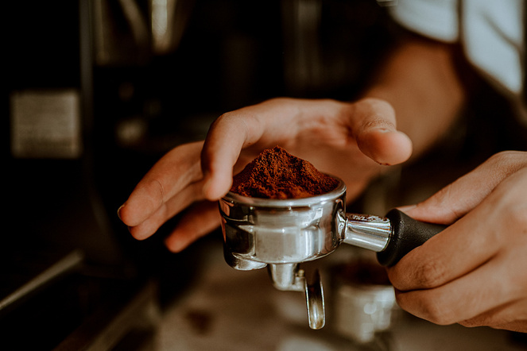

Objective
User-Friendly Design:
Easy navigation for customers and administrators.
Efficient Management:
Fast food ordering and inventory tracking.
Optimal Performance:
Utilize data structures and algorithms for speed.
3

Slide 4
Modules and Functions used:
1. Header Files
stdio.h: For standard input/output operations.
stdlib.h: For dynamic memory operations and program termination.
string.h: For string manipulation like copying and comparing.
2. Data Structures
(Double linked list used)
MenuItem: Structure for menu items (id, name, price).
Order: Structure for order items (itemId, quantity).
3.Authentication & Interfaces
login(): Validates credentials for admin and user.
adminPanel(): Interface for admin functions.
-userPanel(): Interface for user functions.
5

Slide 5
Functions under Admin panel :
addMenuItem(): Adds a new item to the menu.
displayMenu(): Displays all current menu items.
removeMenuItem(): Removes an item based on its ID.
logout() : logout from admin panel and get back to main menu
Functions under User panel :
placeOrder(): Adds an item to the user's order.
displayOrder(): Displays all items in the current order.
displayBill(): Displays total bill and clears orders.
clearOrders(): Frees memory used by order list.
logout() : logout from user panel and get back to main menu
6

Slide 6
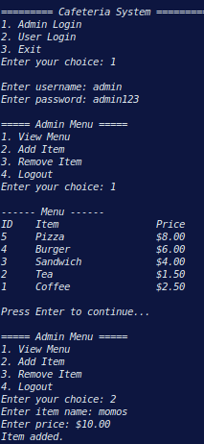


Output
7

Slide 7
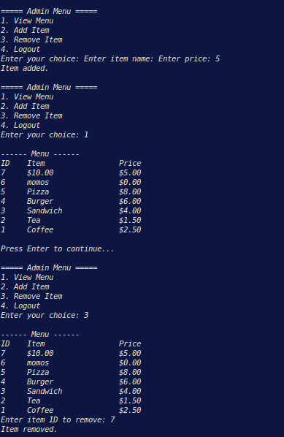
Output
8

Slide 8
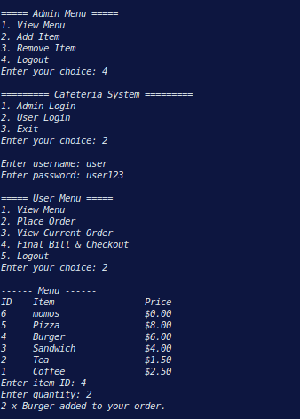
Output
9

Slide 9
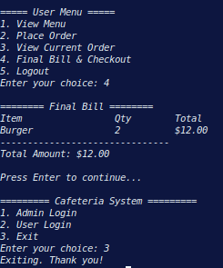
Output
10

Slide 10





Lessons Learnt
01
Efficient Coding and Problem-Solving*
- Writing optimized code that minimizes resource usage and maximizes performance.
- Breaking down complex problems into manageable parts and solving them efficiently.
02
Effective Data Management*
- Organizing and structuring data for efficient retrieval and manipulation.
- Choosing the right data structures to suit the problem's requirements.
03
Scalable System Design*
- Designing systems that can handle increased traffic, data, or user demands.
- Building systems that are flexible and adaptable to changing requirements.
04
Practical Application of Theoretical Concepts*
- Applying theoretical knowledge of C and DSA to real-world problems.
- Translating concepts into working solutions that meet practical needs
11

Slide 11


Conclusion
The Cafeteria Management System project has successfully demonstrated the development of an efficient and user-friendly system for managing cafeteria operations. By leveraging C programming language and data structures and algorithms, the system provides optimal performance, scalability, and reliability.
12

Slide 12

13

